Slide 1
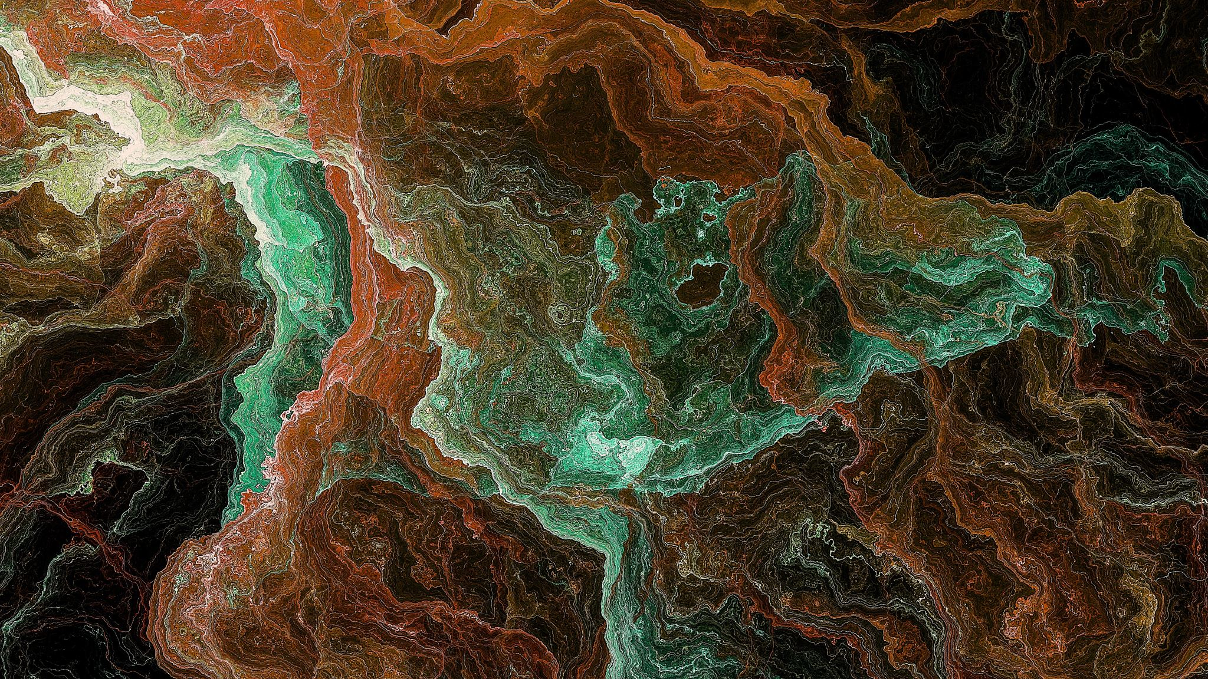
Image Caption Generation USING CLIP
TEAM members :
Panjanathan [211520243037]
Nithish M [211520243035]
Sai Prassad n [21152023046]
Prakash v [211520243042]
GUIDED BY:
MRS. VIDHYA MUTHULAKSHMI

Slide 2
outlook
Problem Statement
Abstract and Keywords
Objective
Literature Survey
Proposed System
Output Screenshot
References

Slide 3

Problem statement
Despite the prevalence of digital images in everyday life, blind individuals face significant challenges in accessing visual content. Traditional assistive technologies often fall short in providing meaningful descriptions of images, limiting the ability of blind users to engage with digital content effectively. The aim of this project is to develop an image captioning generator specifically tailored to address the needs of blind individuals. The key challenge lies in generating accurate and descriptive captions that convey the essential information contained within images, enabling blind users to form a mental image of the scene or object. This entails not only accurately identifying objects and activities within the image but also providing contextually relevant descriptions that facilitate comprehension.

Slide 4

ABSTRACT and Keywords
This paper presents a novel approach to image caption generation harnessing the power of OpenAI's CLIP (Contrastive Language-Image Pretraining) model. CLIP, a state-of-the-art multimodal model, enables the understanding of images and text in a unified semantic space. By leveraging CLIP's robust representations of both images and corresponding text, we propose an image caption generator that seamlessly combines visual and textual cues for accurate and contextually relevant captioning. Our method utilizes CLIP's pre-trained vision and language encoders to encode images and generate captions using a decoding strategy that encourages coherence and diversity. Through extensive experimentation and evaluation on diverse image datasets, we demonstrate the effectiveness and versatility of our approach in producing descriptive and informative captions across various domains. We envision our CLIP-based image caption generator as a powerful tool with applications in content generation, visual storytelling, and accessibility, ultimately bridging the gap between visual and textual modalities in the digital realm.
Keywords : OpenAI CLIP, Multimodal model, Contrastive learning, Semantic space, Visual and textual cues, Pretrained encoders, Fine-tuning techniques, Content generation, Visual storytelling, Bridging modalities

Slide 5

objective
The objectives can be outlined as follows:
Enhance Accessibility: Develop a tool that enhances accessibility for blind individuals by providing accurate and descriptive captions for digital images, enabling them to access and comprehend visual content independently.
Leverage Deep Learning Techniques: Utilize advanced deep learning techniques, such as convolutional neural networks (CNNs) and recurrent neural networks (RNNs), to extract meaningful features from images and generate natural language captions that accurately describe the content.
User-Centric Design: Prioritize user feedback and incorporate user-centered design principles to create a tool that is intuitive, user-friendly, and meets the specific needs and preferences of blind users.

Slide 6
Literature survey
From Show to Tell: A Survey on Deep Learning-based Image Captioning (2021): This survey provides a comprehensive overview of deep learning-based image captioning models, covering architecture, techniques, evaluation metrics, and recent advancements. It delves deeper than other surveys and analyzes a large number of papers. (arXiv: [https://arxiv.org/pdf/2107.06912])
A Systematic Literature Review on Using the Encoder-Decoder Models for Image Captioning in English and Arabic Languages (2023): This survey focuses on encoder-decoder models for image captioning, comparing techniques and implementation specifics across different languages (English and Arabic). It also discusses recent developments like Conditional GAN-based models and meta-learning approaches. (MDPI: [https://www.mdpi.com/2076-3417/13/19/10894])

Slide 7
Literature survey
Image Captioning using Deep Learning: A Systematic Literature Review (2019): This survey mainly focuses on the period 2017-2019, analyzing the application of various deep learning methods like CNNs, LSTMs, and attention mechanisms in image captioning. It explores commonly used datasets and evaluation metrics.
A Systematic Literature Review on Image Captioning (2020): This survey provides a brief overview of advancements in image captioning within the last four years, highlighting key techniques, challenges, and promising directions. It emphasizes the recent surge in research and the need for more comprehensive comparisons of results. (MDPI: [https://www.mdpi.com/2076-3417/9/10/2044])

Slide 8
Literature survey
A Review of Deep Learning Techniques for Image Captioning (2020): This review dives into the technicalities of deep learning models used for image captioning, explaining architectures like CNNs, LSTMs, and their specific functionalities within the context of caption generation.

Slide 9
Proposed sysytem
Traditional CNN-RNN: In traditional CNN-RNN models for image captioning, a convolutional neural network (CNN) is typically used for image feature extraction, followed by a recurrent neural network (RNN), often with LSTM or GRU cells, for generating captions sequentially.
OpenAI's CLIP: CLIP employs a transformer-based architecture, combining vision and language encoders to understand images and text in a unified semantic space. It does not follow the traditional CNN-RNN structure but instead learns joint representations of images and text through contrastive learning.
CLIP is trained using contrastive learning, where the model learns to align similar images and text samples while pushing apart dissimilar pairs. This training paradigm enables CLIP to generalize across diverse datasets and domains without the need for task-specific supervision.

Slide 10
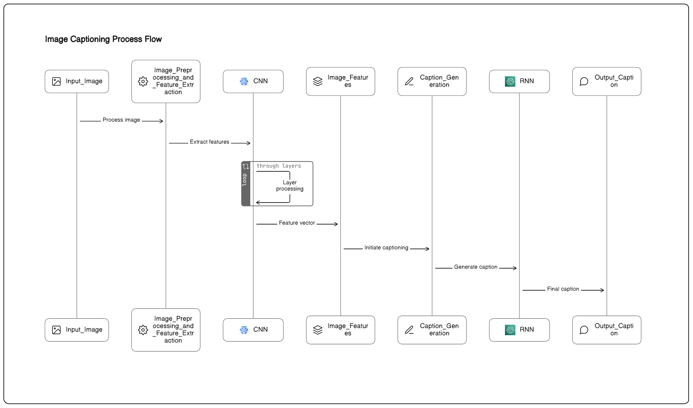
Architecture diagram

Slide 11
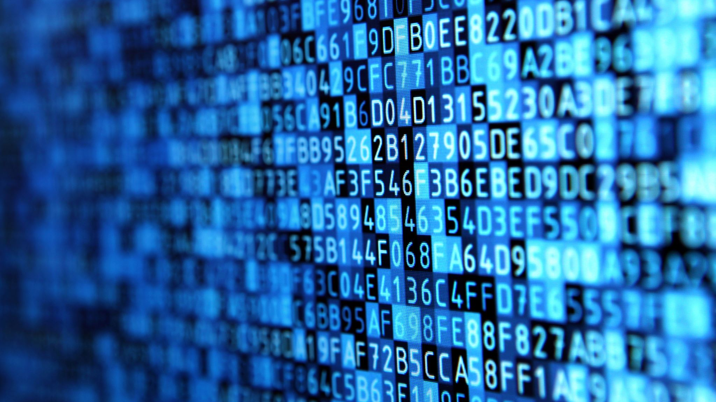
Github Link [code]
nithishscripter/image-captioner-clip: An image captioner that automatically generates descriptive captions for images. Describe the content and context of an image using natural language. (github.com)

Slide 12
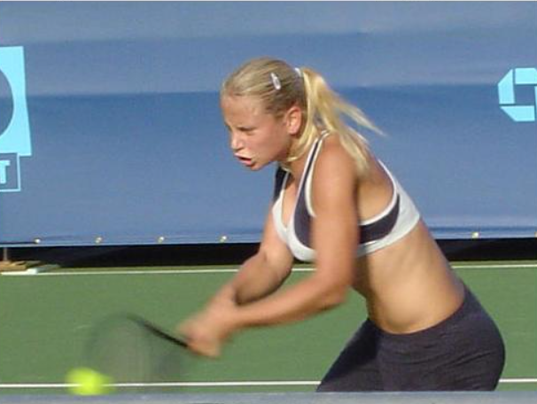
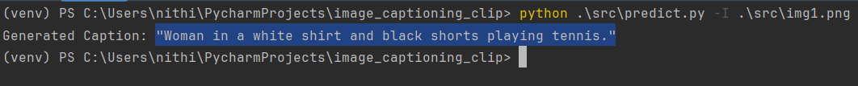
OUTPUT

Slide 13
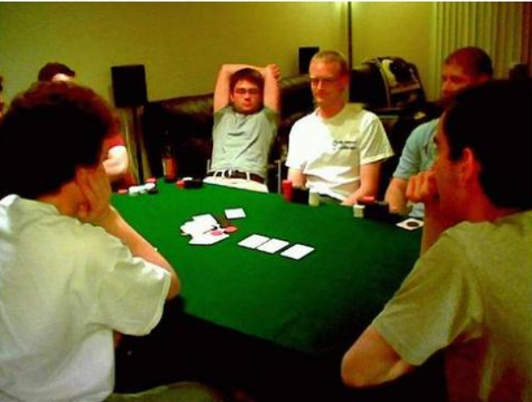
OUTPUT

Slide 14
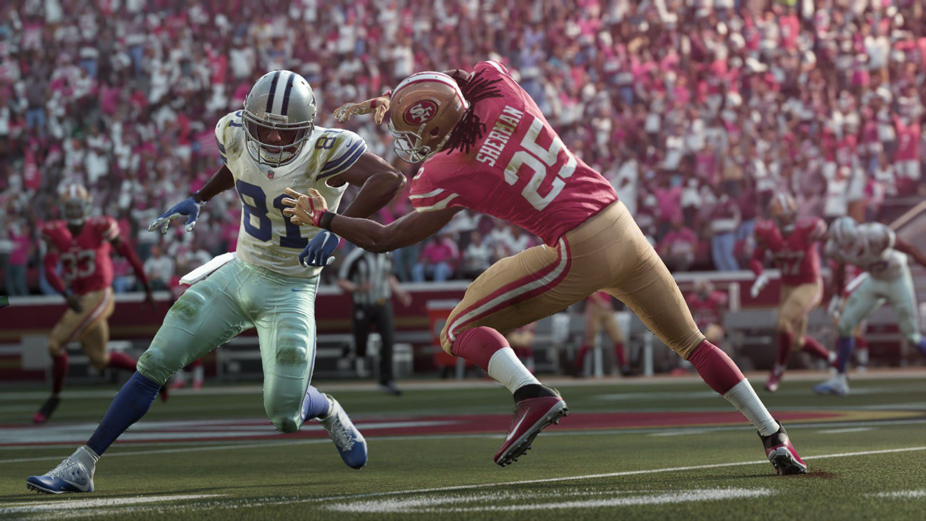
OUTPUT

Slide 15
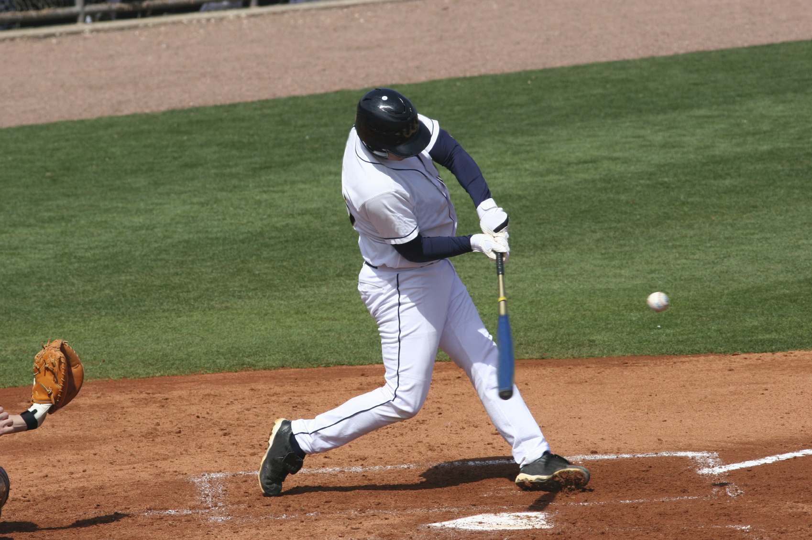
OUTPUT

Slide 16
REFERENCE
[1] A. Karpathy and L. Fei-Fei, ‘‘Deep visual-semantic alignments for generating image descriptions,’’ in Proc. IEEE Conf. Comput. Vis. Pattern Recognit. (CVPR), Jun. 2015, pp. 3128–3137.
[2] O. Vinyals, A. Toshev, S. Bengio, and D. Erhan, ‘‘Show and tell: A neural image caption generator,’’ in Proc. IEEE Conf. Comput. Vis. Pattern Recognit. (CVPR), Jun. 2015, pp. 3156–3164.
[3] P. Anderson, B. Fernando, M. Johnson, and S. Gould, ‘‘SPICE: Semantic propositional image caption evaluation,’’ in Proc. 14th Eur. Conf. Comput. Vis. (ECCV), Amsterdam, The Netherlands. Berlin, Germany: Springer, Oct. 2016, pp. 382–398
[4] J. Wu, T. Chen, H. Wu, Z. Yang, G. Luo, and L. Lin, ‘‘Fine-grained image captioning with global-local discriminative objective,’’ IEEE Trans. Multimedia, vol. 23, pp. 2413–2427, 2021.
[5] J. Han, D. Zhang, G. Cheng, N. Liu, and D. Xu, ‘‘Advanced deep-learning techniques for salient and category-specific object detection: A survey,’’ IEEE Signal Process. Mag., vol. 35, no. 1, pp. 84–100, Jan. 2018.
[6] L. Ruotsalainen, A. Morrison, M. Makela, J. Rantanen, and N. Sokolova, ‘‘Improving computer vision-based perception for collaborative indoor navigation,’’ IEEE Sensors J., vol. 22, no. 6, pp. 4816–4826, Mar. 2022.

Slide 17
THANK YOU

